Slide 1
Monopolistic Competition
A market situation in which a large number of firms produce similar but not identical products
Entry into the industry is relatively easy Other Characteristics 1) significant sellers in a highly competitive market 2) Differentiated products 3) Sales promotion and advertising Oligopoly- Few sellers cement Industry, barriers to entry Duopoly-two firms Pepsi and coca-cola

Slide 2
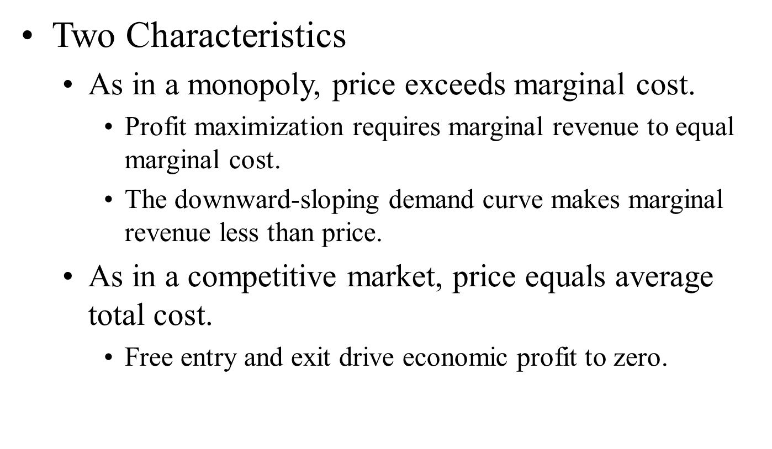
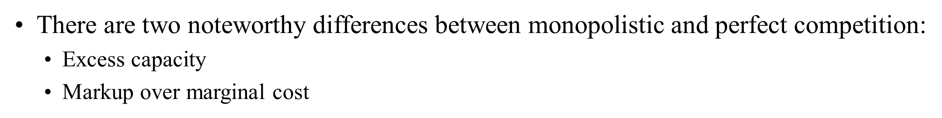

Slide 3
Advertisement and Product branding
When firms sell differentiated products and charge prices above marginal cost, each firm has an incentive to advertise in order to attract more buyers to its particular product
Firms that sell highly differentiated consumer goods typically spend between 10 and 20 percent of revenue on advertising.
Overall, about 2 percent of total revenue, or over $200 billion a year, is spent on advertising.

Slide 4
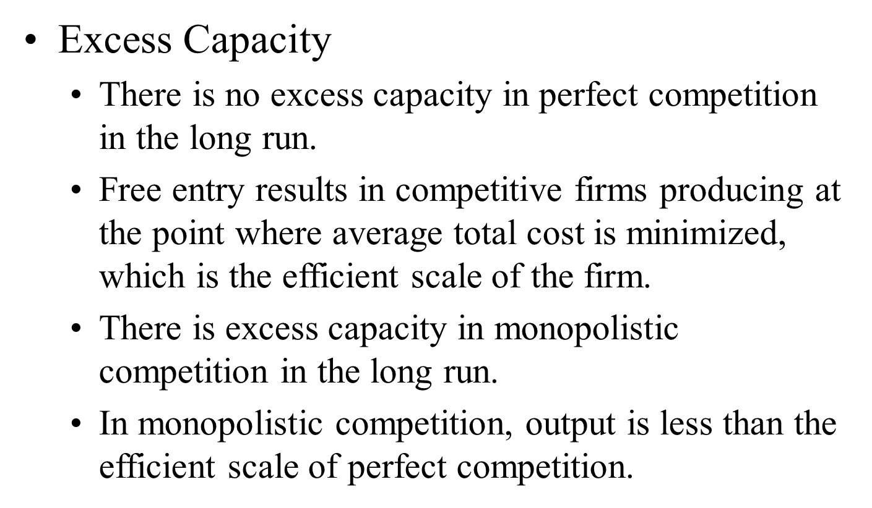

Slide 5
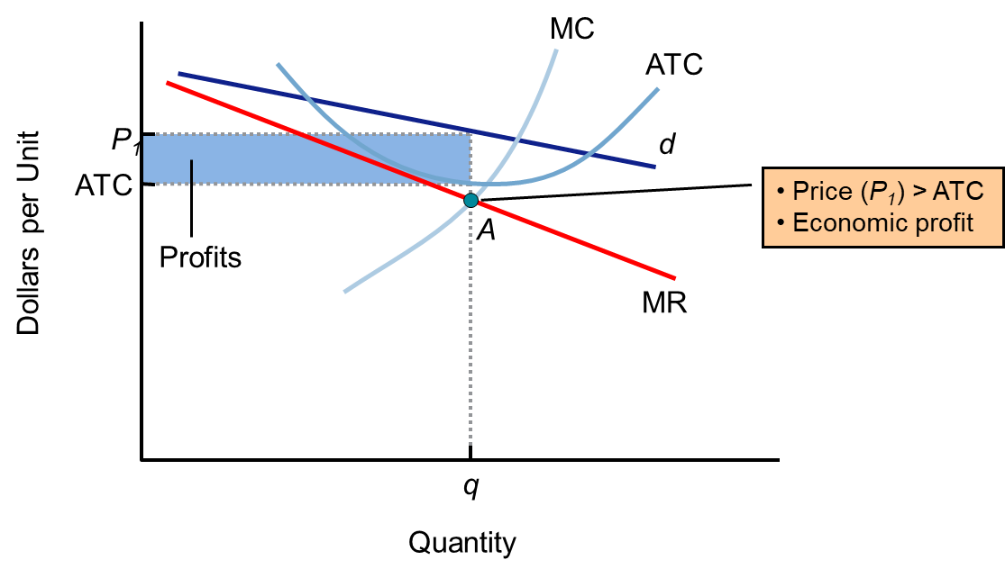
Price output determination

Slide 6
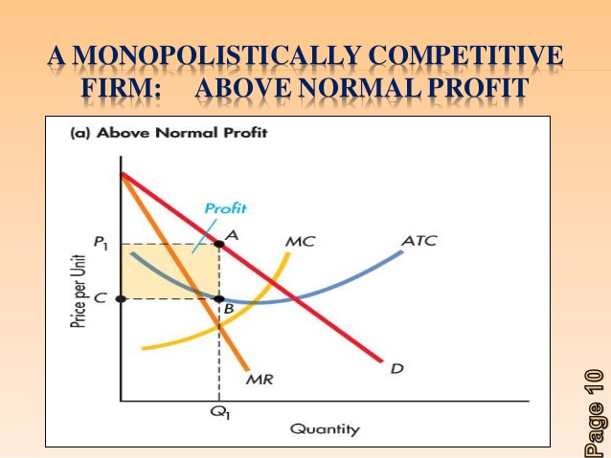
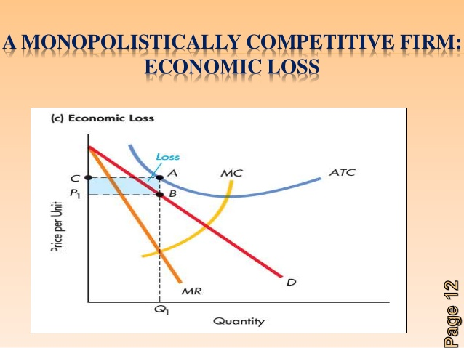
Price output determination

Slide 7
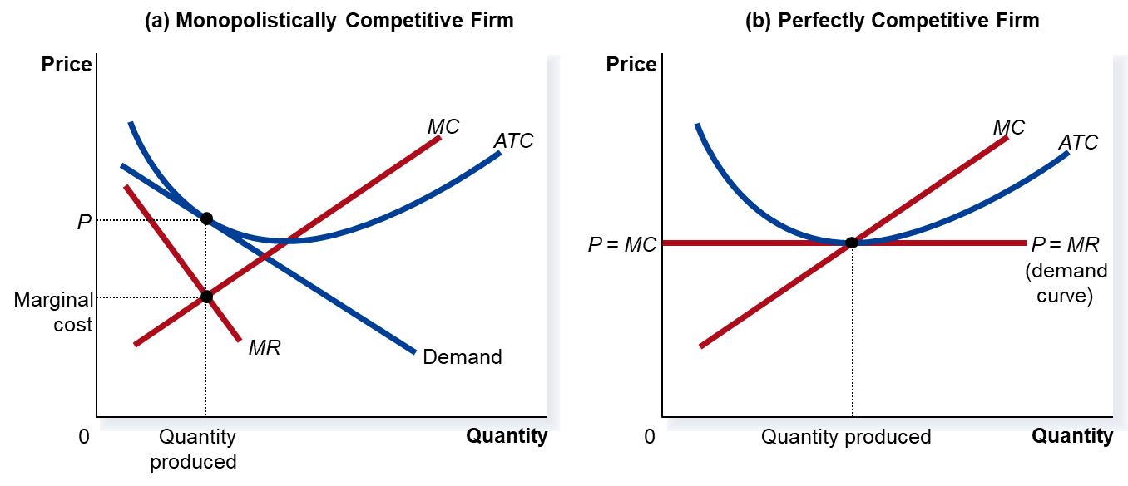
Monopolistic V/s Perfect competition

Slide 8
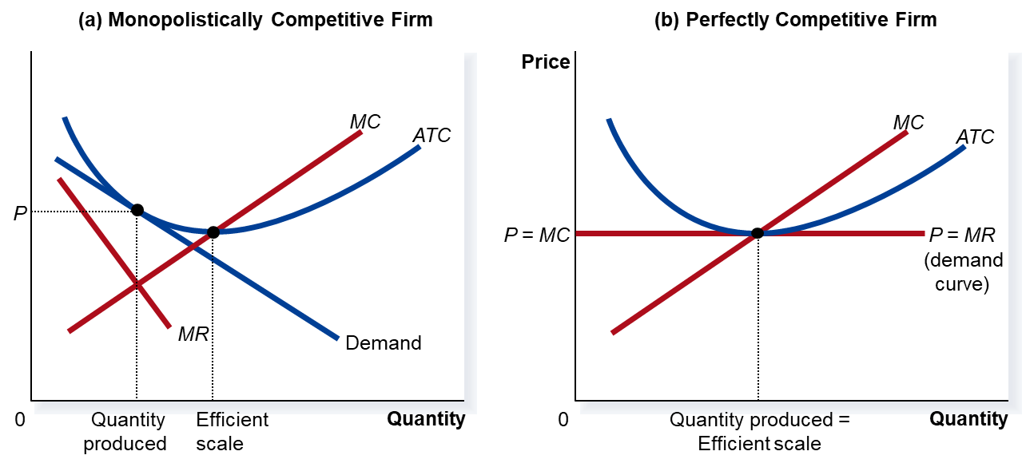
Monopolistic V/s Perfect competition
Markup over Marginal Cost For a competitive firm, price equals marginal cost. For a monopolistically competitive firm, price exceeds marginal cost. Because price exceeds marginal cost, an extra unit sold at the posted price means more profit for the monopolistically competitive firm.

Slide 9

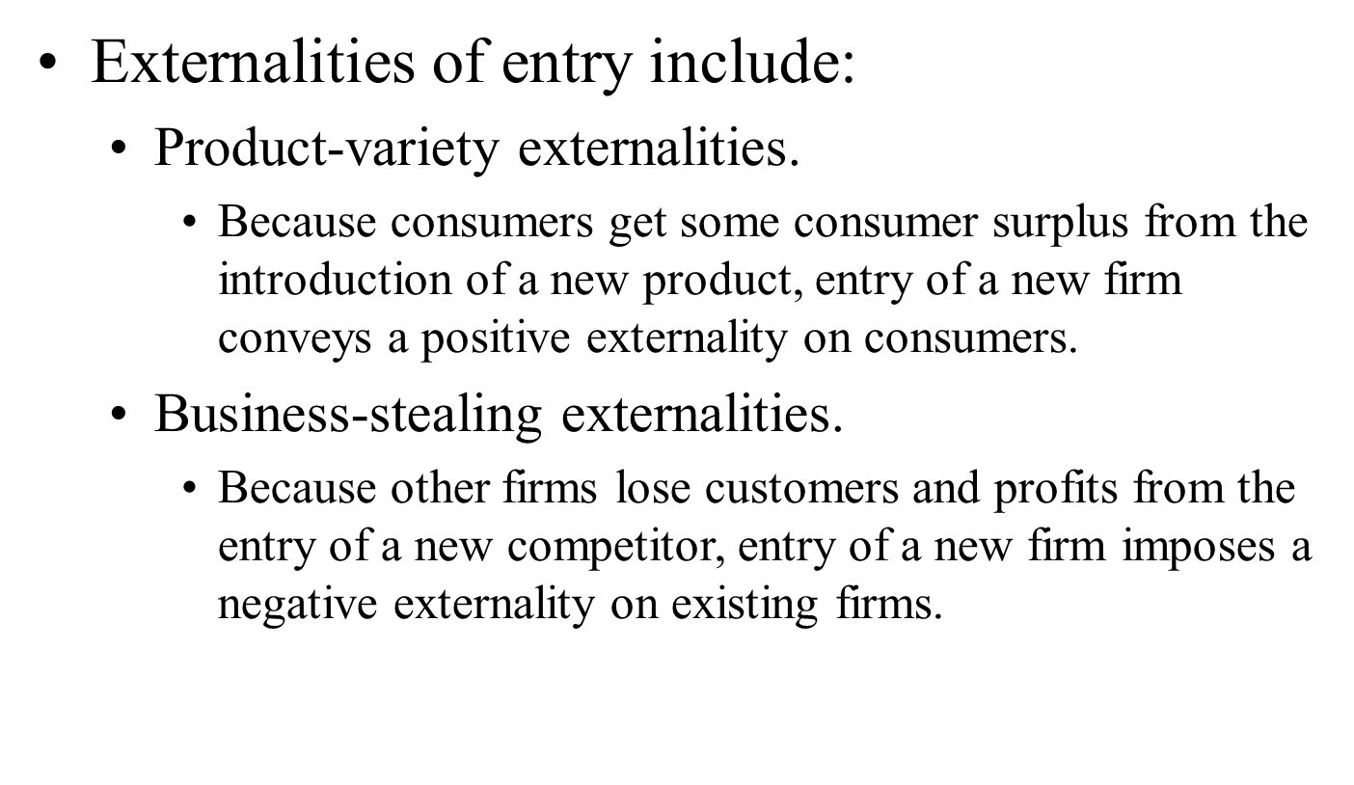
Monopolistic Competition and the Welfare of Society

Slide 10
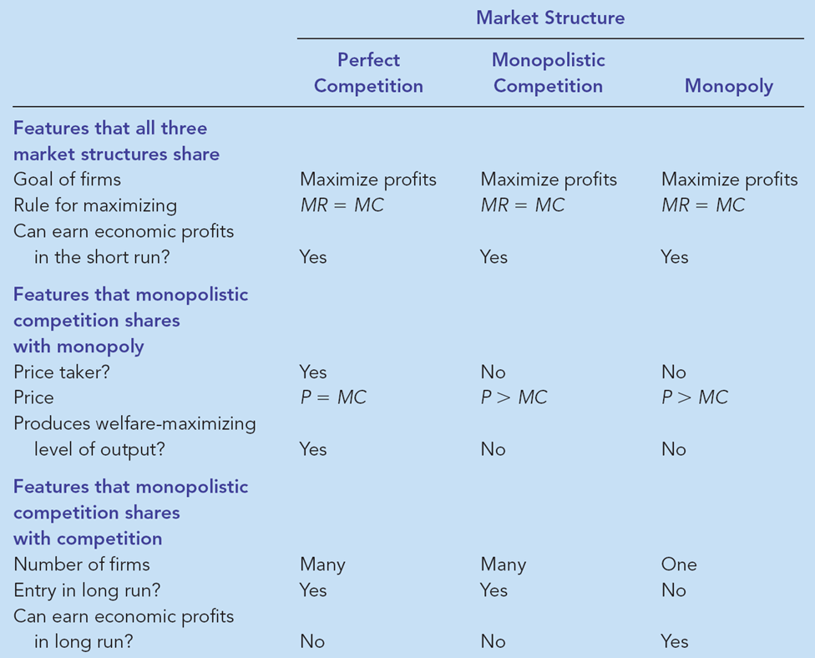
Monopolistic Competition: Between Perfect Competition and Monopoly

Slide 11
A monopolist has the cost function TC(y) = 200y + 15y2 and faces the demand function given by p = 1200 10y. What output maximizes its profit? What is the profit-maximizing price? What is its maximal profit?
Find the output(s) for which MC(y*) = MR(y*).
For each output you find, check to see whether the condition MC'(y*) MR'(y*) is satisfied.
For each output that satisfies the first two conditions, check to see if profit is nonnegative.
If there are any outputs satisfing these three conditions, the one that has the highest profit is the optimal output for the monopolist. (Most probably there is at most one output that satisfies the three conditions.) If there is no output that satisfies the three conditions the the optimal output for the monopolist is 0

Slide 12
Example
A monopolist has the cost function TC(y) = 200y + 15y² and faces the demand function given by p = 1200 10y.
What output maximizes its profit? What is the profit-maximizing price? What is its maximal profit?

Slide 13
